Slide 1
Inheritance-II
Dr. Zahid Halim

Slide 2
Rewriting point and circle classes
class Point
{
protected:
int x,y;
public:
Point(int,int);
void display() ;
};
Point::Point(int a,int b)
{
x=a;
y=b;
}
void Point::display()
{
cout<<"point = [" <<x<<","<<y<<"]";
}

Slide 3
class Circle : public Point
{
double radius;
public:
Circle(int,int,double);
void display();
};
Circle::Circle(int a,int b,double c):Point(a,b) {
radius = c;
}
void Circle::display() {
Point::display();
cout<<" and radius = "<<radius;
}

Slide 4
void main(void)
{
Circle c(3,4,5);
c.display();
}

Slide 5
Three-Level Inheritance Hierarchy
Three level point/circle/cylinder hierarchy
  Point
    x-y coordinate pair
  Circle
    x-y coordinate pair
    Radius
  Cylinder
    x-y coordinate pair
    Radius
    Height

Slide 6
class Point
{
protected:
int x,y;
public:
Point(int,int);
void display();
};
Point::Point(int a,int b)
{
x=a;
y=b;
}
void Point::display()
{
cout<<"point = [" <<x<<","<<y<<"]";
}

Slide 7
class Circle : public Point
{
protected:
double radius;
public:
Circle(int,int,double);
void display();
double GetArea();
};
Circle::Circle(int a,int b,double c):Point(a,b) {
radius = c;
}
void Circle::display() {
Point::display();
cout<<" radius = "<<radius;
}
double Circle::GetArea() {
return 3.14 * radius * radius;
}

Slide 8
class Cylinder:public Circle
{
double height;
public:
Cylinder(int,int,double,double);
void display();
double GetVolume();
};
Cylinder::Cylinder(int a,int b,double r,double h):Circle(a,b,r) , height(h){
}
double Cylinder::GetVolume() {
return GetArea() * height;
}
void Cylinder::display() {
Circle::display();
cout<<" height = "<<height;
}

Slide 9
void main(void)
{
Cylinder c(3,4,2.5,3.7);
c.display();
cout<<"\nVolume of cylinder is : “ <<setprecision(4)<<c.GetVolume();
}
Output:
point=[3,4] radius = 2.5 height = 3.7
Volume of cylinder is : 72.61

Slide 10
Order of execution of Constructors/Destructors
Instantiating derived-class object
  Chain of constructor calls
    Derived-class constructor invokes base class constructor
      Implicitly or explicitly
    Base of inheritance hierarchy
      Last constructor called in chain
      First constructor body to finish executing
      Example: Point/Circle/Cylinder hierarchy
        Point constructor called last
        Point constructor body finishes execution first

Slide 11
Order of execution of Constructors/Destructors
Destroying derived-class object
  Chain of destructor calls
    Reverse order of constructor chain
    Destructor of derived-class called first
    Destructor of next base class up hierarchy next
      Continue up hierarchy until final base reached
        After final base-class destructor, object removed from memory

Slide 12
Example
class Point
{
protected:
int x,y;
public:
Point(int,int);
void display();
~Point() { cout<<"\nPoint Class Destructor\n"; }
};
Point::Point(int a,int b) {
cout<<"\nPoint Class Constructor\n";
x=a;
y=b;
}
void Point::display() {
cout<<"point = [" <<x<<","<<y<<"]";
}

Slide 13
class Circle : public Point
{
protected:
double radius;
public:
Circle(int,int,double);
void display();
~Circle() { cout<<"\nCircle Class Destructor\n"; }
};
Circle::Circle(int a,int b,double c):Point(a,b) {
cout<<"\nCircle Class Constructor\n";
radius = c;
}
void Circle::display() {
Point::display();
cout<<" radius = "<<radius;
}

Slide 14
class Cylinder:public Circle
{
double height;
public:
Cylinder(int,int,double,double);
void display();
double GetVolume();
~Cylinder() { cout<<"\nCylinder Class Destructor\n"; }
};
Cylinder::Cylinder(int a,int b,double r,double h):Circle(a,b,r) {
cout<<"\nCylinder Class Constructor\n";
height=h;
}
double Cylinder::GetVolume() {
return 3.14 * radius * radius * radius;
}
void Cylinder::display() {
Circle::display();
cout<<" height = "<<height;
}

Slide 15
void main(void)
{
Cylinder c(3,4,2.5,3.7);
}
Output:
Point Class Constructor
Circle Class Constructor
Cylinder Class Constructor
Cylinder Class Destructor
Circle Class Destructor
Point Class Destructor

Slide 16
Overriding
The function in the derived class with the same function (variable) name will override the functions (variables) in the base classes.
But you can still invoke or get the overrode functions(variables) with scope resolution operator ”::”.
We have used overriding in previous examples…
  display function of Point, Circle and Cylinder

Slide 17
Types of inheritance
public
private
protected

Slide 18
Public Inheritance
With public inheritance, public and protected members of the base class become respectively public and protected members of the derived class.

Slide 19
Protected Inheritance
Public and protected members of the base class become protected members of the derived class.

Slide 20
Private Inheritance
With private inheritance, public and protected members of the base class become private members of the derived class.

Slide 21
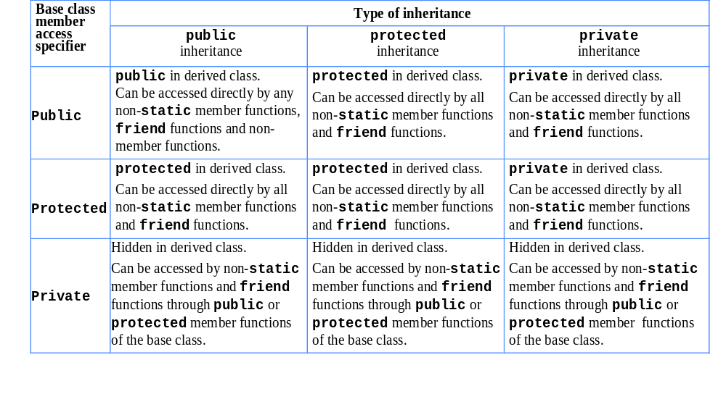
public, protected and private Inheritance

Slide 22
References
Book Code: A

Slide 23
Quiz
Develop class Polynomial. The internal representation of a Polynomial is an array of terms. Each term contains a coefficient and an exponent. The term
2x⁴
has the coefficient 2 and the exponent 4. Develop a complete class containing proper constructor and destructor functions. The class should also provide the following overloaded operator capabilities:
Overload the addition operator (+) to add two Polynomials.
Overload the subtraction operator (-) to subtract two Polynomials.

Slide 24
Inheritance-III
Dr. Zahid Halim

Slide 25
Multiple Inheritance
Employee
Student
Salaried
GraduateAssistant

Slide 26
What is Multiple Inheritance?
If class A inherits from more than one class, ie. A inherits from B1, B2, ..., Bn, we speak of multiple inheritance.
This may introduce naming conflicts in A if at least two of its superclasses define properties (data members or member functions) with the same name.

Slide 27
//simple example showing multiple inheritance
class base1 {
public:
void funbase1(void) { cout<<"funbase1"; }
};
class base2 {
public:
void funbase2(void) { cout<<"funbase2"; }
};
class derived:public base1, public base2 {
public:
void funderived(void) { cout<<"funderived";}
};
void main(void) {
derived der;
der.funbase1();
der.funbase2();
der.funderived();
}

Slide 28
//Example 2 (showing ambiguity because of multiple inheritance)
typedef unsigned long ulong;
class Student {
ulong id;
unsigned age;
public:
unsigned GetAge() const { return age; }
ulong GetId() const { return id; }
void SetAge( unsigned n ) { age = n; }
void SetId( ulong n ) { id=n; }
};
class Employee {
public:
unsigned GetAge() const { return age; }
void SetAge( unsigned n ) { age = n; }
void SetId( ulong n) { id=n; }
ulong GetId(void) const { return id; }
private:
unsigned age;
ulong id;
};

Slide 29
class Salaried :public Employee {
float salary;
public:
float GetSalary() const { return salary; }
void SetSalary( float s ) { salary=s; }
};
class GradAssistant :public Student, public Salaried {
public:
void Display() const;
};
void GradAssistant::Display() const {
cout<<GetId()<<","<<GetSalary()<<","<<GetAge(); //ambiguity
}
void main(void) {
GradAssistant ga;
ga.SetAge(20); //ambiguity
ga.SetId(15); //ambiguity
ga.Display(); //ambiguity inside display function
}
//program will not compile and will generate errors

Slide 30
What is the solution?
Call functions explicitly by specifying name of class and using scope resolution operator to remove ambiguity
  Direct solution: Student::SetAge() or Salaried::SetAge().
  Virtual inheritance

Slide 31
//Example 2 corrected
typedef unsigned long ulong;
class Student {
ulong id;
unsigned age;
public:
unsigned GetAge() const { return age; }
ulong GetId() const { return id; }
void SetAge( unsigned n ) { age = n; }
void SetId( ulong n ) { id=n; }
};
class Employee {
public:
unsigned GetAge() const { return age; }
void SetAge( unsigned n ) { age = n; }
void SetId( ulong n) { id=n; }
ulong GetId(void) const { return id; }
private:
unsigned age;
ulong id;
};

Slide 32
class Salaried :public Employee {
float salary;
public:
float GetSalary() const { return salary; }
void SetSalary( float s ) { salary=s; }
};
class GradAssistant :public Student, public Salaried {
public:
void Display() const;
};
void GradAssistant::Display() const {
cout<<Employee::GetId()<<","<<Salaried::GetSalary()<<",“
<<Salaried::GetAge();
}
void main(void) {
GradAssistant ga;
ga.Employee::SetAge(20);
ga.Employee::SetId(15);
ga.Salaried::SetSalary(2000);
ga.Display();
}
//no ambiguity now, program will compile successfully now

Slide 33
References
Book Code: A

Slide 34
Quiz
Create a class to represent complex numbers
Add a function to overload the stream insertion operator to display the complex number as follows
  3+5i
Do not write main
Make one constructor
Do not make any destructor

